Slide 1
Ankle and Foot: Mobility, Movement, and Squats
Presented by: Kjell Mann, PT, DPT and Chloe Hallyburton, PT, DPT

Slide 2
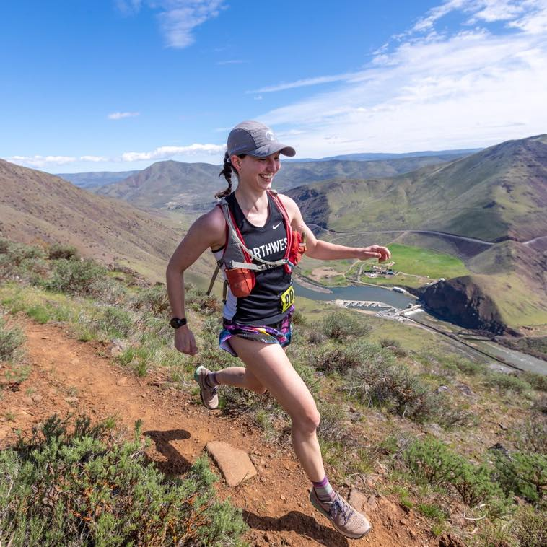
The Presenters
Kjell Mann, PT, DPT
CSCS training
Anticipated completion Nov, 2020
Sports-specific focus
Selective Functional Movement Assessment (SFMA)
Movement expert
Hockey, Soccer, Track
Chloe Hallyburton, PT, DPT
Women’s health specialist
Pre, peri, and post-partum, post-menopausal care
Sports emphasis – return to running, lifting, impact sports
Orthopedic manual therapist
Special interest in foot and ankle mechanics

Slide 3
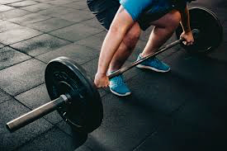
Foot and ankle^{1,2}
Anatomy of the Foot/Ankle
Distal tibiofibular joint
Subtalar joint
*Talocrural joint*
Midtarsals
Forefoot
Muscles/Ligaments/Tissues Involved
Anterior Talofibular Ligament (ATFL)
Posterior ankle muscles
Calf muscles
Anterior ankle
Tibialis Anterior
Foot intrinsics
Peroneals

Slide 4
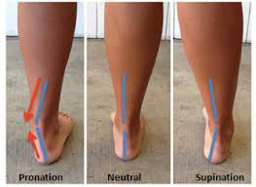
Biomechanics of the ankle and the surrounding joints^{1,2}
Ankle mechanics
The ankle joint has a total of three degrees of motion
Forward/backward, side to side, rotational
Pronation
(eversion, dorsiflexion, abduction)
Mobile
Supination
(inversion, plantarflexion, adduction)
Rigid/Stable

Slide 5
How does this all relate to how we function and squat?^{2,4}
The ankle is our first contact with the ground reaction forces
How it interacts will often affect the entire kinetic chain above it
Knee, hip, low back
Squats
Limited ankle dorsiflexion can lead to compensations
Wider hip stance
More load into adjacent joints
Lack of depth in our squatting

Slide 6
Let’s Look At The Overhead Squat4,5,6
-The overhead squat shows us all of the moving parts.
Optimizing your position is key
Stacking joints on top of each other
This includes the shoulder, hips, and ankle
-To achieve this stacked position:
*Keep an upright torso
*Knees over toes
*Have those shoulders in hyperabduction
WHENEVER IT COMES TO A SQUAT, WE NEED TO ALWAYS LOOK AT THE FIRST CONTACT….. THE FOOT/ANKLE!

Slide 7
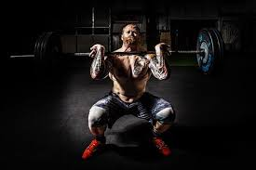
To reach an ideal deep squat you will need ankle mobility and maintain knees over toes
You have probably heard of the phrase: “never bring your knees in front of your toes”…… let’s talk about why this idea is false

Slide 8
What's the research and history behind the fear of knees coming over toes?³
1978 Duke University Study first made this claim
Undue stress could be placed into the knees was the underlying case
Limited evidence to refute this statement
In 2003, research confirmed that knee stress increased by 28% when the knees moved past the toes
HOWEVER: Hip stress increased nearly 1,000% when forward movement of the knee was restricted.
Better advice:
Keep your knees aligned over your second toe

Slide 9
Squatting Form
What is this person doing right?
How could he increase the force into his ankles?
What ways could he bias his:
Ankle
Hips
Back

Slide 10
What do we look for to recognize when our ankle/foot mobility is lacking?^{4,5}
Athletes may be inclined to lean TOO FAR FORWARD with their torso
Back Squat this is fine
Front/Overhead Squat is a big NO
Other compensations include:
Heels lifting off the ground, creating an unstable foundation for lifting
Feet spinning outward during the performance of the squat . .
Looking up the chain to see if you are compensating
Knees caving in
Hip or pelvic shifts that are asymmetrical

Slide 11
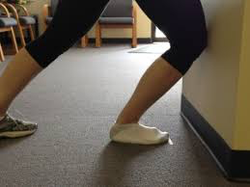
Self-assessment of our ankle motion^{5,6}
Dorsiflexion: Use a wall and go into a half kneel position
Move your body back one hand length
While in the half-kneel, attempt to bring your front knee over your toes
Be sure the heel on the front foot does not raise up
The knee should be able to touch the wall without difficulty
Tibial internal rotation assessment

Slide 12
4 useful exercises to assist with squatting and ankle mobility⁵
Eccentric Calf Raise
Both single leg and double leg
PAILS/RAILS (Isometric Calf Loading)
Goblet Squat with Dorsiflexion Emphasis
Split Squats with a Forward Knee Emphasis

Slide 13
Exercise #1: Eccentric Calf Raises
The focus is on the slow lowering of the calf
Eccentrics work on “lengthening” the muscle
Begin with both legs
Progress to lowering with one leg at a time when you have the necessary strength
Adding weight or height can increase the demand

Slide 14
Exercise/Mobility Drill #2: Dorsiflexion Isometric Loading (PAILS/RAILS)
PAILS/RAILS (Progressive/Regressive Angular Isometric Loading)
Get into position by going into a half kneel position with the focus of knees over toes
Lean forward into the stretch using either your bodyweight or a kettlebell for assist
Hold for 1-2 min
Follow this up by contracting your calf muscles
Drive your toes into the ground (push as hard as you can without moving)
15-20 sec
Follow this by engaging your anterior/tibialis muscles
15-20 sec
Stretch/relax in position for 1-2 min
Repeat 2-3x

Slide 15
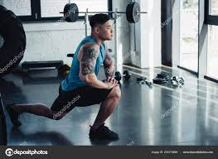
Exercise/Mobility Drill #3 and #4
#3: Goblet Squat with Ankle Dorsiflexion Bias
Get into a squat position
Rest your forearms inside your knees, then pry them out
The weight of the kettlebell should pull your knees forward
Rock back and forth to help with the mobility
#4: Split Squat with Forward Knee Emphasis
Go down into a split squat with the legs spread apart
Squat down with an emphasis on bringing that knee forward
It should also help with thigh strength

Slide 16
Other Mobility Recommendations
3 Way Calf Drills
Forward soleus/calf stretches into wall with an mobility component
Pistol Squat Progressions
Ankle Mobilizations
Lateral Tibial Glide
Internal Rotation Motor Training

Slide 17
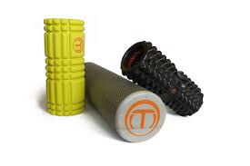
SMASHING THE ANKLE/FOOT
Foam rollers
Lacrosse Ball
Kettlebell
Use the handle to press against the calf
Barbell
Seated with your legs extended
Suggestions:
1-2 min with a slow and steady pressure

Slide 18
So what if you need compensations?^{2,5}
Always be sure to discuss your deficits/limitations with your coach
Past injuries, structural faults, etc.
Variations or ankle repositioning may be ideal:
Hip mobility
Knees tend to pull out into a torso position
Use towels or padding behind the heels
Propping the heels up will provide a crutch for those limited in ankle dorsiflexion
Be careful with how you modify!!
Sometimes our bodies do find ways to assist our motion but not in ideal patterns

Slide 19
Summary
The foot/ankle is a complex yet adaptable region of the body
Encourage proper movements and stretches into your routine
Be sure to check for faulty compensations that may be hindering your performance
There are the BIG 3 that can lead to your movement impairments
Mobility (tissues, joint)
Motor control (coordination)
Strength/stability deficits

Slide 20
What Can Physical Therapy Do For You?
Pain and injury are a limiting factor
Assessment of the impairment
Education on the condition
Workout adaptations
Tissue relief techniques, management strategies
Better understanding of your injury
Interventions
Soft tissue mobilization, cupping, taping, and pain reduction
Motor coordination, task-specific training
Exercises tailored to your condition

Slide 21
References
1. Smith MD, Lee DL, Russel T, Matthews M, MacDonald D, Vincenzino B. How Much Does The Talocrural Joint Contribute to Ankle Dorsiflexion During the Weight Bearing Lunge Test? A Cross-sectional Radiographic Validity Study. JOSPT 49(12): 934-941, 2019.
2. Bell D, Bolling M, Lewek M, Padua D. Effect of Limiting Ankle Dorsiflexion Range of Motion on Lower Extremity Kinematics and Muscle Activation Patterns During a Squat. Journal of Sports Rehab. 21:144-150, 2012.
3. Fry, A, Smith, JC, Schilling BK. Effect of knee position on hip and knee torques during barbell squats. J Strength Cond Res. 17(4): 629-633. Nov 2003.
4. Bird, SP, and Casey, S. Explore the front squat. Strength and Conditioning Journal 34(2): 27–33, 2012.
5. National Strength and Conditioning Association. Exercise Technique Manual for Resistance Training. (3rd ed.). Champaign, IL: Human Kinetics; 42-49, 2016.
6. Schoenfeld, BJ. Squatting kinematics and kinetics and their application to exercise performance. Journal of Strength and Conditioning Research 24(12): 3497–3506, 2010.

